Slide 1
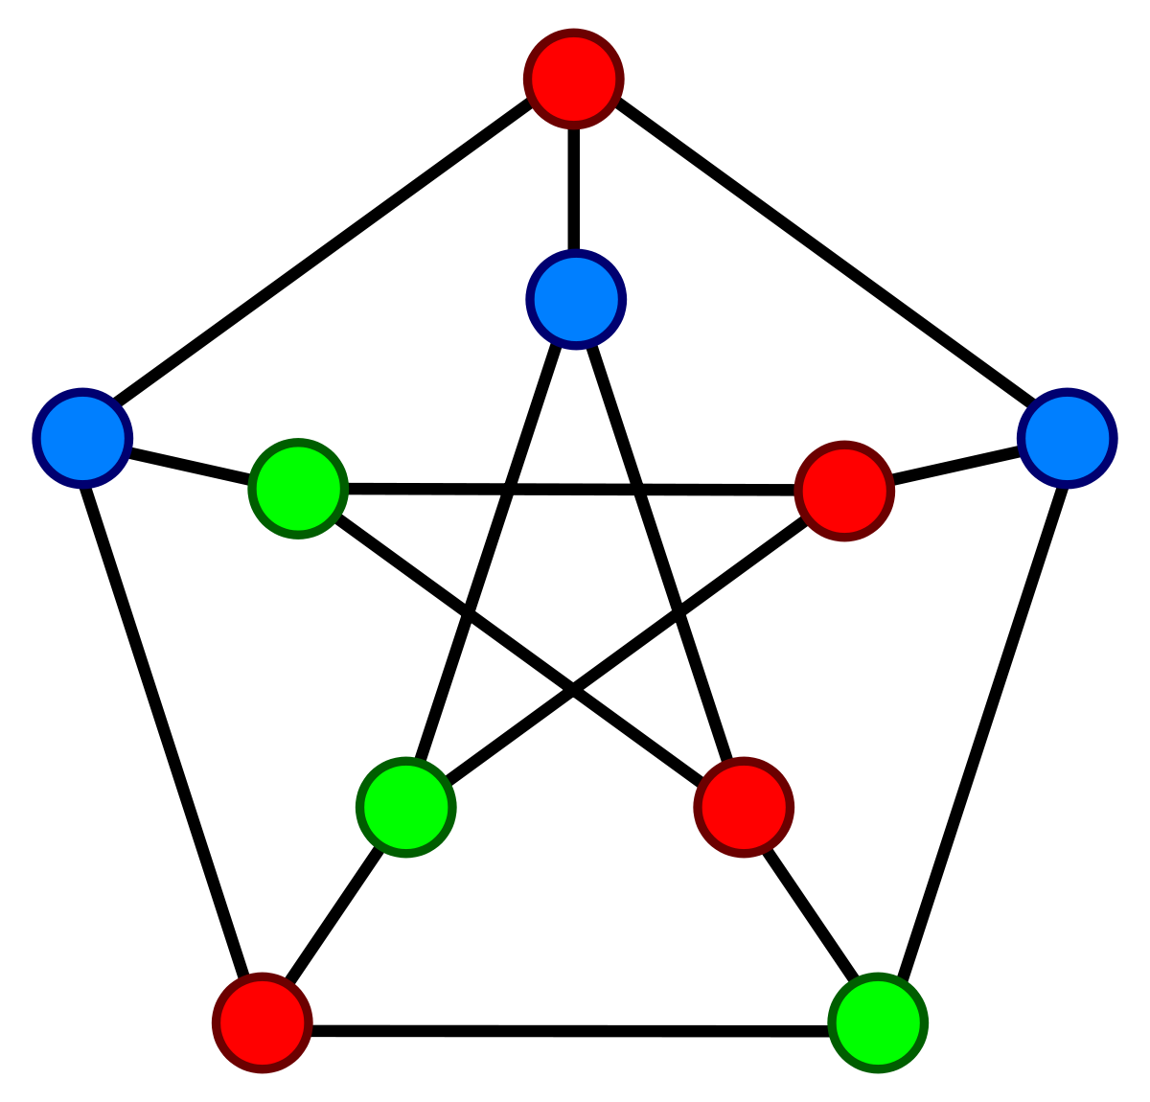
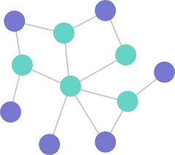
Graph Theory
AI Inspire

Slide 2

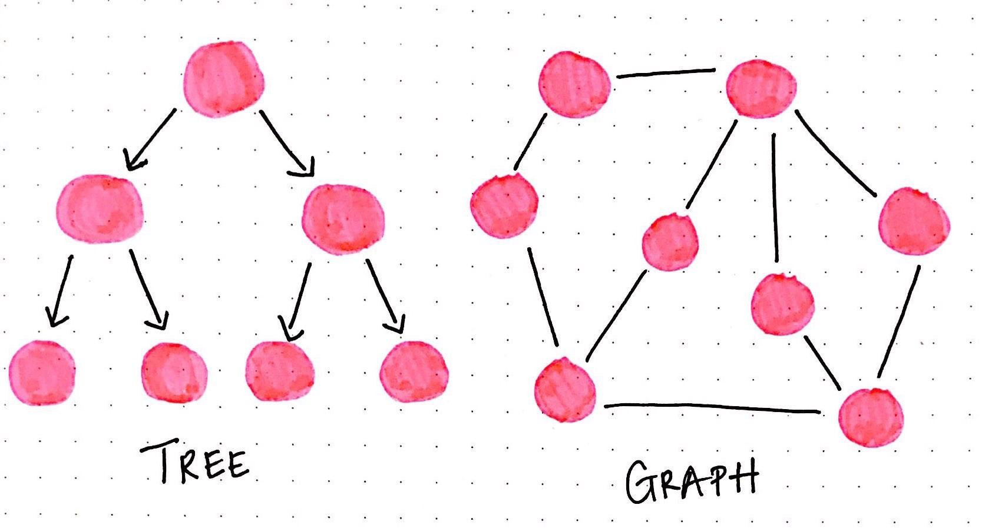
Basics

Slide 3
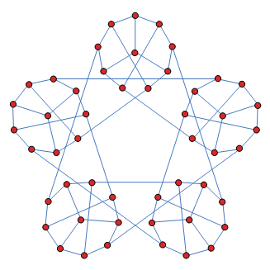
What is Graph Theory?
Mathematical study/theory of graphs
Properties
Applications
Graph is composed of
Vertices/Nodes/Points
Connected by Edges/Arcs/Lines
Study of relationships

Slide 4

Importance/Impact
Used in a multitude of diff. Comp. apps
Use algorithms to tackle diff. Problems
Ex. : Shortest path problem
Simpler to express data in graph vs. table
See relationships between data
Better understanding of data

Slide 5

Where is it used?
Social media
Social networks
Facebook
Instagram
Snapchat, etc.
Connect Platforms
Connecting students or prof. With each other
Shortest Route
GPS

Slide 6
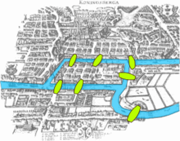
History
Leonhard Euler - 1736
Greatest mathematician
Founder of Graph Theory
7 Bridges of Konigsberg Bridge Problem
Activity
https://www.mathsisfun.com/activity/seven-bridges-konigsberg.html

Slide 7


Definitions

Slide 8
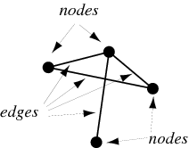
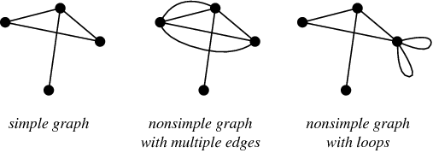
Simple Vocab
Graph
Set of vertices/nodes connected with a set of edges
Loop
Edge with same vertex at each end
Degree of vertex
Number of edges which have that vertex as an endpoint
Simple Graph
Graph with no loops
No more than one edge connecting a pair of vertices

Slide 9
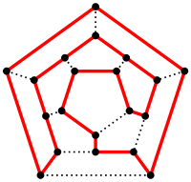
Simple Vocab (cont.)
Walk
Sequence of edges where each edge is the beginning of the consecutively next edge (except last)
Trail
No edge is repeated
Path
No vertex is repeated
Cycle
Closed path
Hamiltonian cycle
Cycle which visits every vertex
Each vertex is only visited once
Cycle is a path

Slide 10
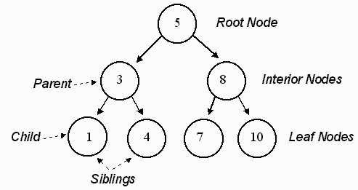
Terms & Definitions
Connected graph
Path exists between every pair of vertices
Tree
Simple connected graph
NO CYCLES!
Complete graph
Simple graph where every pair of vertices is connected by an edge

Slide 11
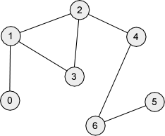
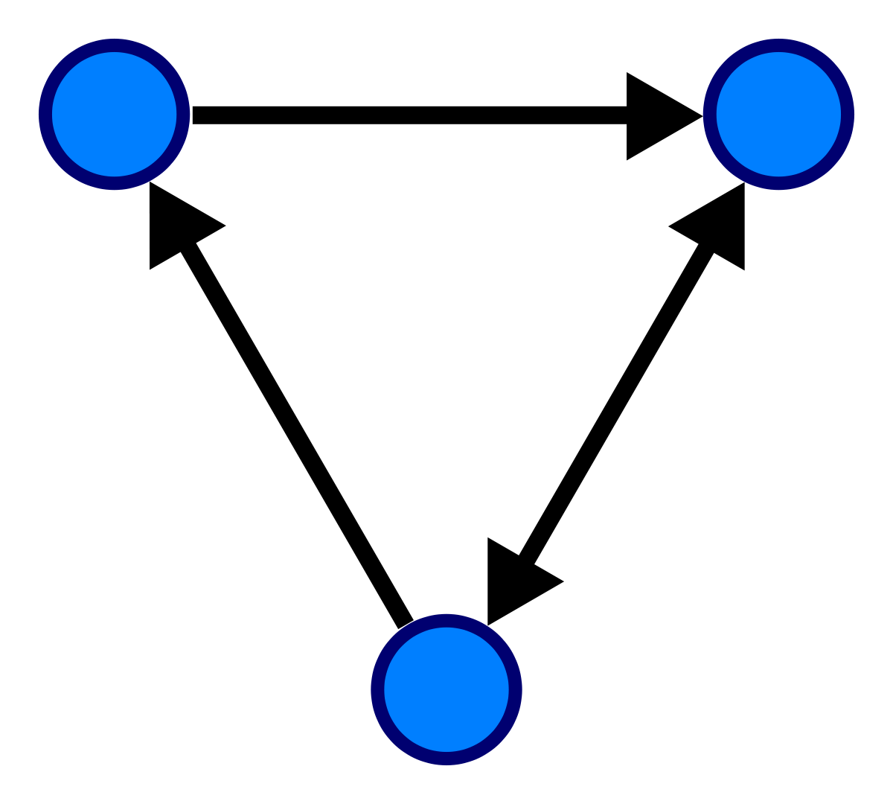
Types of Graphs
Bipartite graph
2 disjoint sets (no elements in common & no vertices between 2 sets are adj.)
Bigraph
Directed graph
All edges are directed
Particular direction
Undirected graph
DAG (Directed Acyclic Graph)

Slide 12
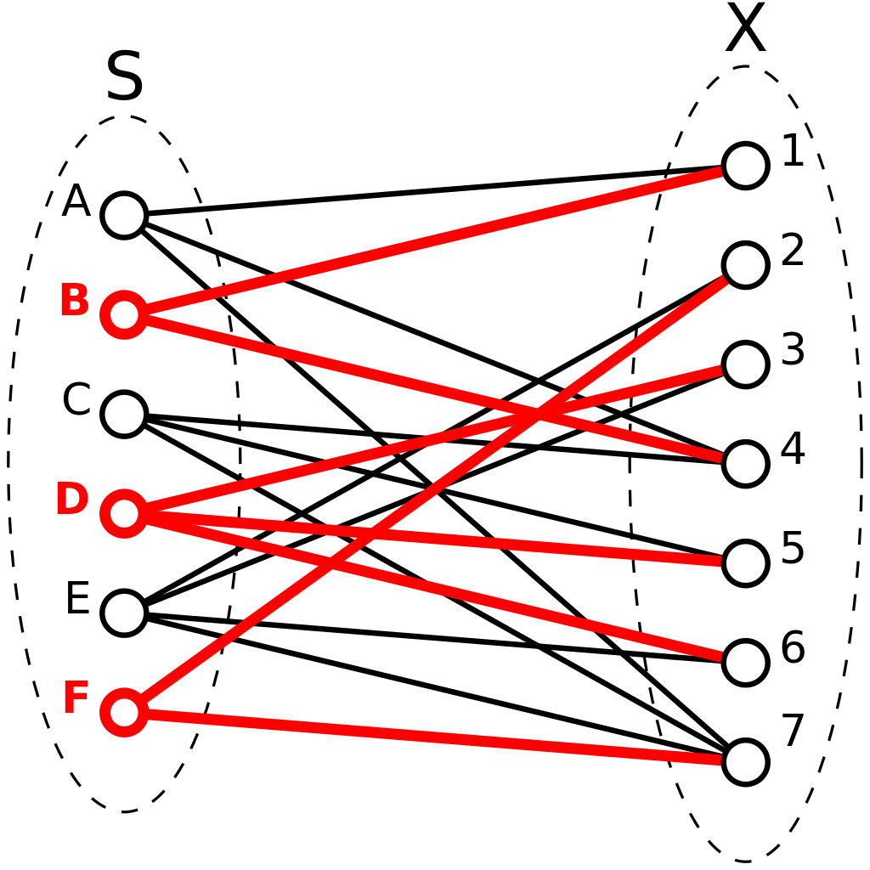
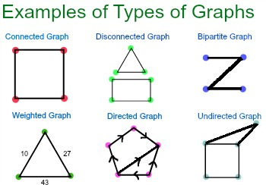
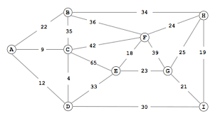
Types of Graphs

Slide 13
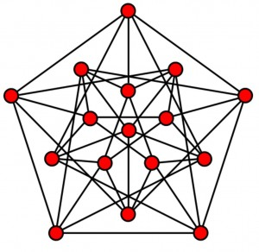
Representing Graphs
Adjacency matrix
Square n * n matrix
Each number indicates whether vertices are adjacent or not
Diagonal : has 0s : vertice can’t be adjacent to itself
2D array in Java
Adjacency list
Represents graph with list
Represents if vertices are adjacent to each other in graph
Represents length if directed graph between adjacent vertices

Slide 14
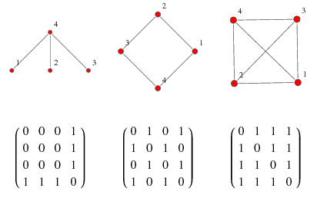
Adjacency Matrix

Slide 15
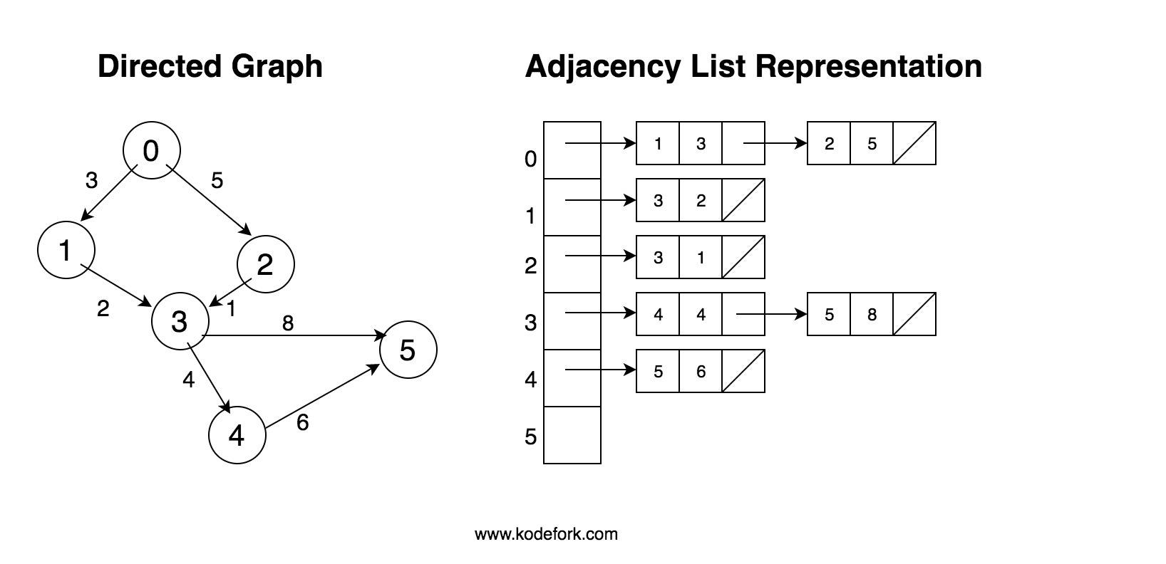
Adjacency List

Slide 16

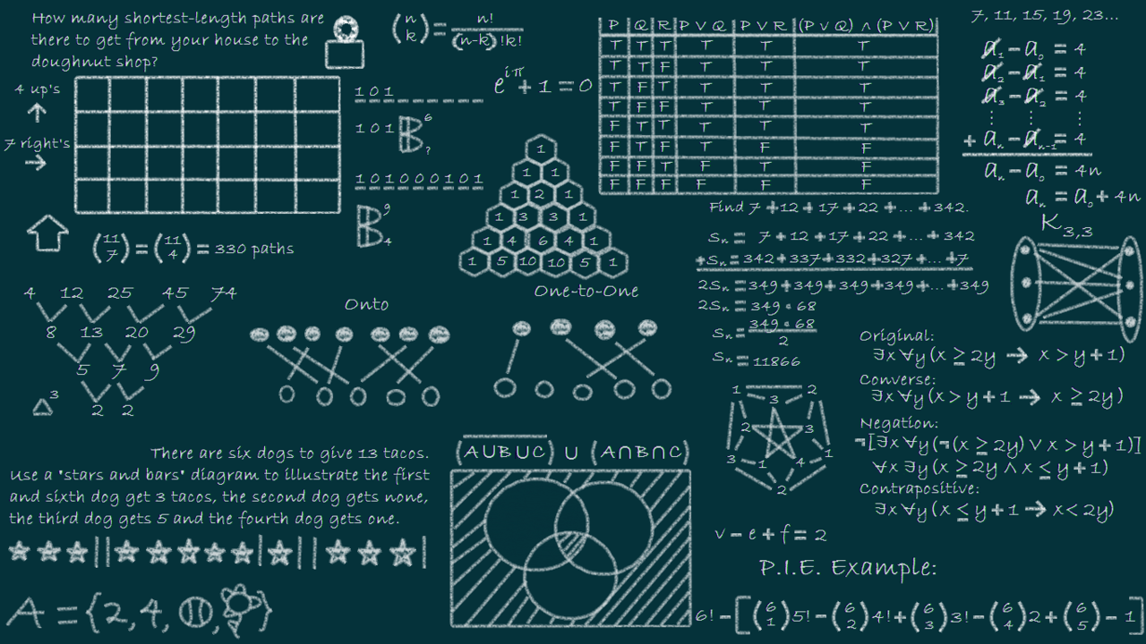
Algorithms & Activities

Slide 17
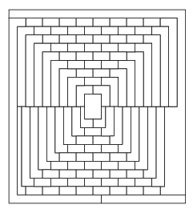
Activity 1 : How Many Colors?
https://www.colorado.edu/education/DMP/activities/graph/ddgact03.html
https://www.colorado.edu/education/DMP/activities/graph/ddghnd03.html

Slide 18

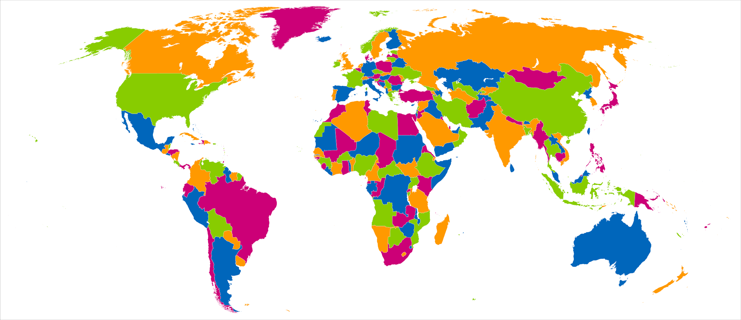
4 COLOR THEOREM
No more than 4 colors are needed to color regions of map
No 2 adjacent regions have same color

Slide 19
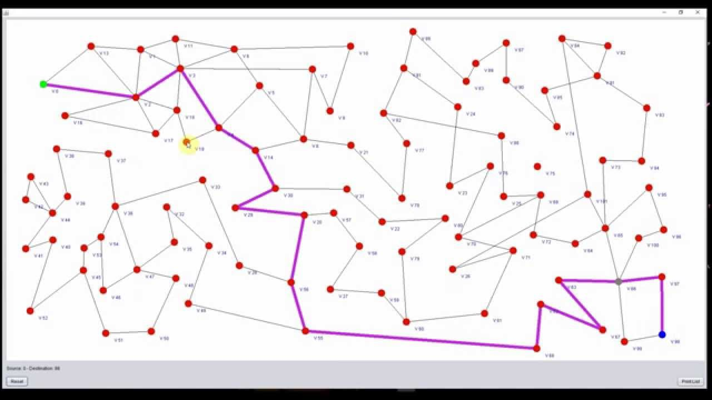
Activity 2 : Shortest Route Problem
https://www.colorado.edu/education/DMP/activities/graph/ddgact04.html
https://www.colorado.edu/education/DMP/activities/graph/ddghnd04.html

Slide 20
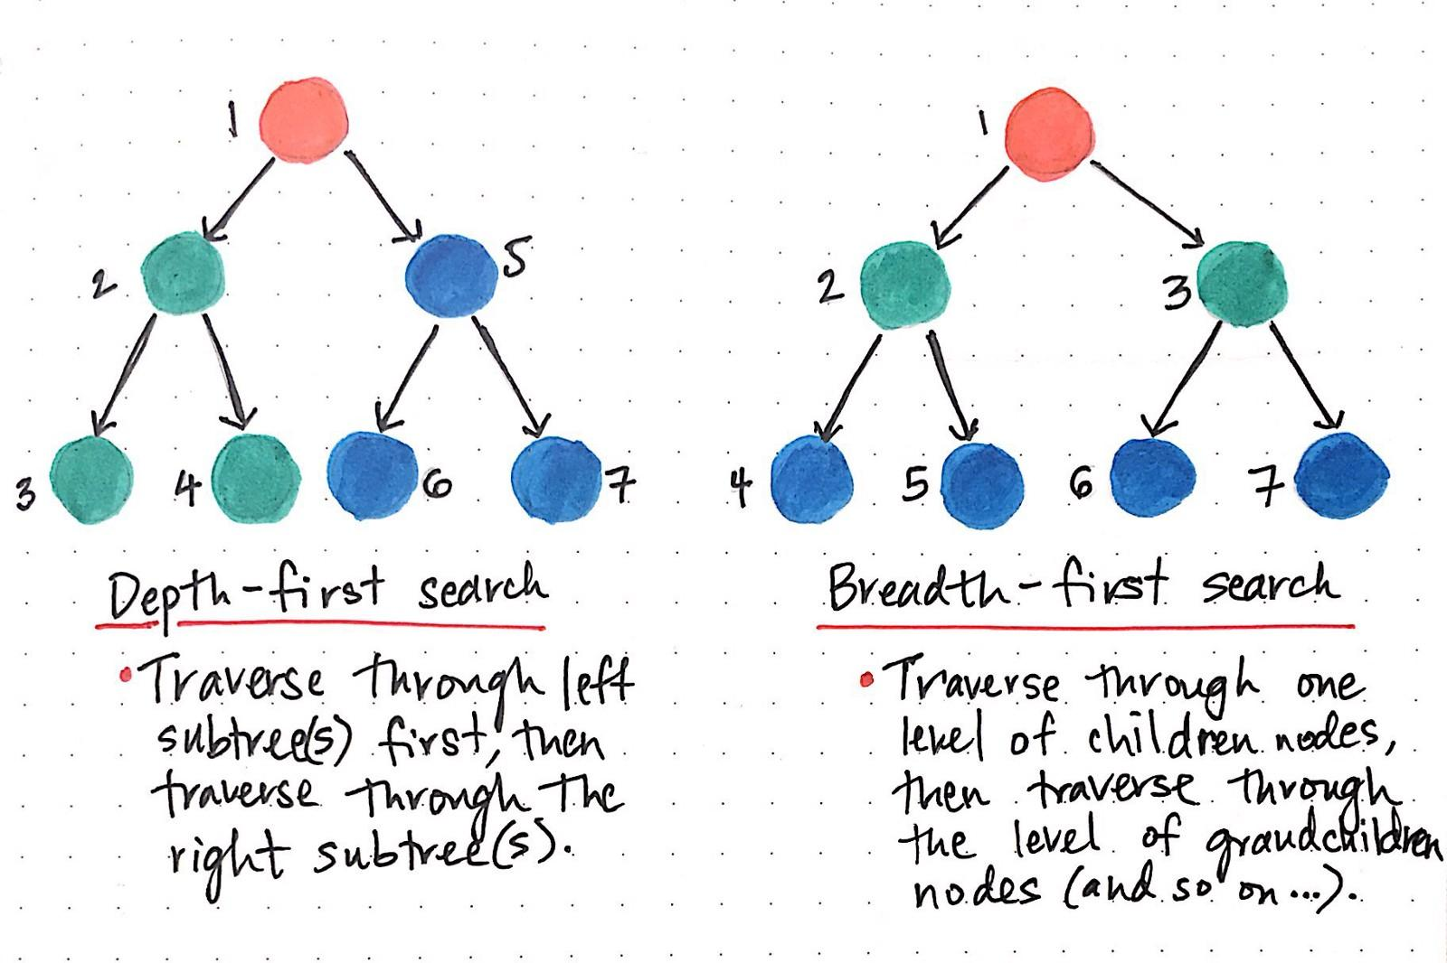
Breadth First Search
Algorithm traversing/searching through graph
Broad
Visits siblings/neighbor nodes over children nodes

Slide 21
Depth First Search
Algorithm traversing/searching through graph
Deep
Visits children nodes over sibling nodes

Slide 22
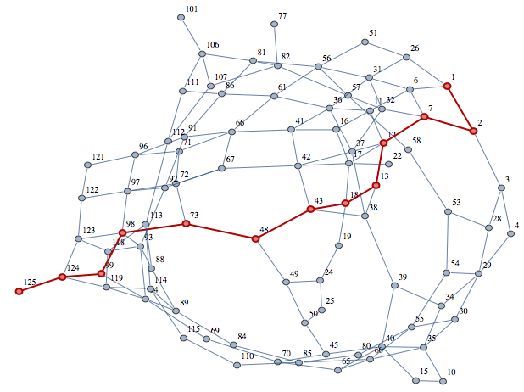
Dijkstra's Shortest Path Algorithm
Shortest path between nodes in a graph
Ex : road networks
Used by GPS and other systems
https://www.youtube.com/watch?v=McXPZz4c0FY

Slide 23
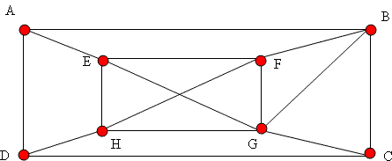
Bonus Activity 3 : Travelling Salesman Problem
https://nrich.maths.org/2325
Visit all cities
Optimal path
Shortest distance
Min travel time

Slide 24

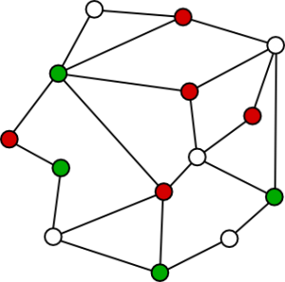
Quick Review of Concepts Learned
https://www.youtube.com/watch?v=82zlRaRUsaY
https://www.youtube.com/watch?v=2iViaEAytxw

